Slide 1
U.S. Small Business Administration
Office of Capital Access
7(a) Connect Quarterly Update
July 12, 2022

Slide 2
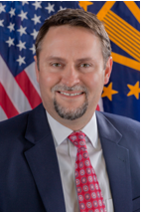
Office of Capital Access
John Miller
Deputy Associate Administrator

Slide 3
Office of Capital Access
Monthly Performance Dashboard
Data as of 06/30/2022

Slide 4
YTD Activity – Total 7(a) and 504
7(a) Lending Activity
504 Lending Activity

Slide 5
YTD Activity – 7(a) Small Dollar Loans
Up to $150k Lending Activity
$150k to $350k Lending Activity

Slide 6
YTD Activity – SBA Express
SBA Express

Slide 7
YTD Activity – Franchise
7(a) Franchise Lending Activity
504 Franchise Lending Activity

Slide 8
YTD Activity – Mission Programs
Microloans
Current FY Microloan approvals underreported due to lag in micro lender reporting.
Community Advantage

Slide 9
YTD Activity – Microloans – Underserved Markets
Minority
Women
Veteran
DISCLAIMER: The information being provided above is derived solely from Agency records that are submitted by the Agency’s participant lenders engaged in making SBA loans. This information is collected by the lenders from SBA loan applicants who provide it on a voluntary basis. It is then forwarded by the lenders to SBA. Since the information is provided by the loan applicants on a voluntary basis, it is not necessarily inclusive of all SBA borrowers, nor can its accuracy be verified by the Agency. Accordingly, SBA cannot make any representation as to the completeness or accuracy of the information provided.

Slide 10
YTD Activity - Surety Bond Guarantee Program
Bid, Payment/Performance Activity
Fiscal Year | Total Bonds | Total Dollars
2022 | 6,116 | $4,578,866,964
2021 | 7,592 | $5,426,307,223
2020 | 7,756 | $5,231,441,829
2019 | 7,598 | $5,044,861,786
2018 | 8,193 | $4,933,174,079
Payment/Performance Activity
Fiscal Year | Guaranteed Bonds | Guaranteed Dollars
2022 | 2,046 | $1,461,291,943
2021 | 2,213 | $1,405,008,674
2020 | 2,266 | $1,462,333,770
2019 | 2,514 | $1,528,275,664
2018 | 2,596 | $1,377,407,761
FY22 Highlights - 1,377 Small Businesses Assisted; 31 Active Surety Companies; 47.6% of Prior Approval Portfolio from QuickApps (≤ $400K); 0.71% Loss Rate; $2,046,329 Recovered; $691,910 Average Contract Size.
Time Period Comparison (activity through 07/02 of each FY)

Slide 11
National Guaranty Purchase Center
Guaranty Purchase
Payment of Expenses
Loan Liquidation
Charge-off and Referral to Treasury
Vanessa Piccioni, Center Director

Slide 12
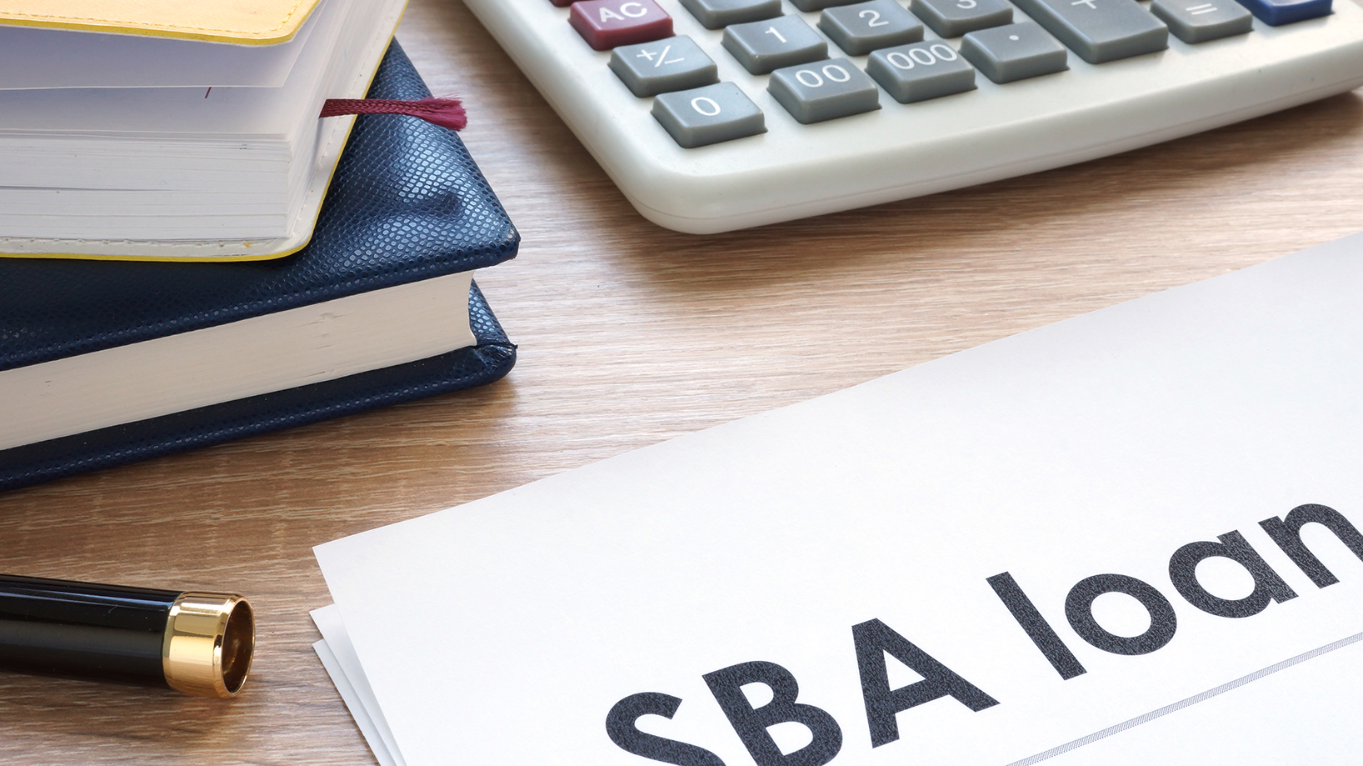
Guaranty Purchase Process
Loan Purchase
According to 13 CFR 120.520, a lender may demand in writing that SBA honor the guaranty on a 7(a) loan if:
  The borrower is in default on any installment for more than 60 calendar days and the default has not been cured.
  All Business Personal Property (BPP) has been liquidated (loans approved on or after May 14, 2007).
NGPC’s Brand Promise on Pre-Purchases
  NGPC will make a purchase decision on the guaranty within 45 days or less if the package is complete.
Deadline for Submission
  If SBA purchases the loan off the secondary market, lenders MUST submit the complete purchase package within 45 calendar days of purchase.
  Post Purchase files are reviewed in four instances.
    If we receive a Wrap-up Report prior to hitting the 2-year mark since the date of purchase.
    If loan is part of the improper payment audit.
    If there is a request for a Note Sale.
    If loan becomes 2-years old since the date of purchase.

Slide 13
Guaranty Purchase Process Continued
The Four Facets of a Guaranty Purchase Review
Origination: Determine that the loan was originated in accordance with regulations and Standard Operating Procedures (SOP) in place at the time of origination.
Closing: Evaluate whether the loan was closed in accordance with the Loan Authorization.
Servicing: Evaluate whether servicing of the loan was in accordance with the loan authorization, loan documentation, regulations, and prudent lending practices.
Liquidation: Evaluate whether liquidation and collection on the defaulted loan was prudent and followed program guidelines.
Top Reason for a Repair or Denial
Lien collateral
Unauthorized use of proceeds
Other liquidation deficiencies
Other servicing deficiencies
Equity Injection not verified (early default)
Expenses
Expenses can only be paid at the time of Purchase or at the time of Charge-off.
New Guaranty Purchase Tabs have been put on the SBA website: https://www.sba.gov/document/sba-form--regular-7a-guaranty-purchase-package-tabs

Slide 14
Portfolio Resolution
The Portfolio Resolution Division (PRD) handles liquidation questions and actions on files serviced at NGPC
Semi-annual Report
  NGPC Send Lenders a list of their purchased but not charged-off loan in March and October of each year.
  Reports should be sent to the NGPCSemiannualReports@sba.gov mailbox.
Exceptions Team
  Lenders have 24 months from that date of purchase to complete liquidation and charge-off.
  If loan is not ready for charge-off a request for an extension can be made to the Exceptions team at NGPC.2YearExceptions@sba.gov mailbox.
Loan Resolution Mailbox
  Respond to liquidation questions. Process requests for Offer-in-Compromise, Receivers, Note Sales, and other liquidation actions.
  Questions and requests can be sent to loanresolution@sba.gov mailbox.
Charge-off
  For each SBA loan classified in liquidation status, a Wrap-up Report must be prepared and submitted to the appropriate SBA loan Center within 30 calendar days of completing all reasonable and cost-effective recovery efforts or upon receipt of a request from SBA, whichever occurs first.
  Charge-off tabs and Care and Preservation of Collateral (CPC) tabs can be sent to the sbachargeoff@sba.gov mailbox.
Treasury Referral
  Enters treasury referral information for Obligors in SBA’s database.
  Send Lender notice confirming the charge-off of the loan and the name of debtors being referred to Treasury.

Slide 15
Portfolio Resolution
Process
Charge-off is NOT Appropriate when:
Loan has a pending post-purchase review that has not been closed.
If there’s ongoing liquidation and/or litigation.
If there’s open bankruptcy.
If there’s a possibility of further recovery.
If the Borrower is complying with an approved workout agreement.
If the Borrower is complying with an approved/term OIC agreement.
If the loan is currently in Paid in Full Status with SBA.
Other Contact Information
secondarymarketliq@sba.gov – secondary market questions
NGPCloanaccounting@sba.gov – Account reconciliation and accounting questions
BirminghamTOPS@sba.gov – Bankruptcy notices and Treasury referral questions
sbalitigation@sba.gov – Litigation plans and requests for Receiver
7aDenials@sba.gov – Status of repair/denial files sent to Headquarters
The Facets of a Charge-off Review
Liquidation: Evaluate the disposition of all collateral.
Recovery: Confirms the receipt of all recovery.
Expenses: Reviews the expense reimbursement requests and determines what should be approved.
Collections: Confirm that all reasonable efforts have been exhausted to achieve recovery.
Top Reason for a Repair or Denial from the Charge-off team
Failure to file a Proof of Claim
Abandonment of collateral with equity available for recovery
Release of Guarantors without SBA approval

Slide 16
Office of Financial Assistance
Ginger Allen
Chief, 7(a) Loan Policy Division

Slide 17
Hot Topics
  Community Advantage Pilot Program resources updates
  Rising interest rates & costs
  7(a) Fixed interest rate maximums
  IRS Form 4506-C draft available for review
  Tax verification & applicants with fiscal year that coincides with calendar year
  Deregulatory Rule

Slide 18
7(a) Community Advantage (CA) Resources Updates
7(a) CA Pilot Program web page:
Recorded trainings
CA Guide
“How to” setup CAFS account and 1502 reporting
Selling on the secondary market
Pledging loans for secured credit facilities
Completing and filing SBA Form 159
etc.
Updated guaranty purchase demand kits sent to CA Lenders on July 5, 2022 – Will be posted on SBA document web page and on the Loan & Guaranty Centers’ pages

Slide 19
New Resources for Community Advantage Pilot Program
We’ve added resources to the SBA 7(a) Lender webpage for the 7(a) Community Advantage Pilot Program
Training & resource materials
Community Advantage Participant Guide
Community Advantage pilot program affiliation rules presentation
Recorded training of Community Advantage pilot program changes for existing CA lenders - May 24, 2022
Recorded training of Community Advantage affiliation rule changes - May 24, 2022
Video: Basics of SBA's secondary market sales - May 31, 2022
Recorded Community Advantage pilot program training for new lenders - June 1, 2022
Video: SBA Form 159 changes for 7(a) and 504 - June 1, 2022
Video: Financing 7(a) loans through secured credit agreements - June 3, 2022
For instructions on setting up CAFS accounts, SBA Form 1502 reporting, submitting SBA Form 159, and using APIs, please see the Fiscal Transfer Agent Resources (FTA wiki)

Slide 20
Interest Rates & Costs are Rising
May 4th: Federal Reserve raised benchmark interest rate by 50 basis points (0.5%) – at that time it was the biggest rate hike since 2000
June 15th: Federal Reserve raised benchmark interest rate by 75 basis points - Wall Street Journal (WSJ) Prime Rate is now 4.75%
SOP 50 10 6, page 240:
  For variable interest rate loans, the base rate in effect on the first business day of the month will determine the basis for the initial interest rate for any complete loan application received by SBA during that month
  The date the “complete loan application is received by SBA” is the date the loan is approved and assigned a loan number (for both delegated and non-delegated processing)
Rising construction costs & rising interest rates: Be thoughtful about rising costs. Construction escrows –Ensure all the pieces will be in place by loan closing (permits, construction contracts, etc.) Reminder: SOP 50 10 6, pg 436: If the construction component of the loan is more than $350,000, lender must obtain evidence of Borrower’s ability to pay cost overruns prior to approving any contract modification.

Slide 21
7(a) Fixed Interest Rates
SOP 50 10 6, page 240, Maximum allowable fixed rate:
  Is the WSJ Prime rate in effect on the first business day of the month plus the allowable spread
  May only be used if the rate will be in effect for the entire term of the loan without adjustment or reset
  SBA will periodically publish the maximum allowable fixed interest rate in the Federal Register
  SBA last published the maximum allowable fixed interest rate in the Federal Register on Nov. 6, 2018: 83 FR 55478

Slide 22
7(a) Fixed Interest Rates
SBA last published the maximum allowable fixed interest rate in the Federal Register on Nov. 6, 2018: 83 FR 55478 - Max fixed 7(a) interest rates for any 7(a) loan, including SBA Express, Export Express, and Community Advantage Pilot Program (excluding EWCP):
  Loans $25,000 or less: Prime + 600 basis points + the 200 basis points permitted by 13 CFR 120.215;
  Loans $25,001 to $50,000: Prime + 600 basis points + the 100 basis points permitted by 13 CFR 120.215;
  Loans $50,001 to $250,000: 10.75% (Prime + 600 basis points);
  Loans greater than $250,000: 9.75% (Prime + 500 basis points);
The Deregulatory Rule, effective Aug. 1, 2022, removes 13 CFR 120.215 from the regulations
The calculation of the maximum 7(a) fixed interest rates as published in 83 FR 55478 remains valid because 13 CFR 120.215 was in effect when the Federal Register Notice (FRN) was published
To avoid confusion in the lending industry, SBA has a draft FRN in clearance that will re-state the maximum 7(a) fixed interest rates with the same aggregate spreads over Prime without reference to 13 CFR 120.215

Slide 23
7(a) Fixed Interest Rates
In accordance with FRN 83 FR 55478 published in 2018- Max fixed 7(a) interest rates for any 7(a) loan, including SBA Express, Export Express, and Community Advantage Pilot Program (excluding EWCP):
  Loans $25,000 or less: Prime + 600 basis points + the 200 basis points permitted by 13 CFR 120.215;
  Loans $25,001 to $50,000: Prime + 600 basis points + the 100 basis points permitted by 13 CFR 120.215;
  Loans $50,001 to $250,000: 10.75% (Prime + 600 basis points);
  Loans greater than $250,000: 9.75% (Prime + 500 basis points);
In accordance with the draft FRN in clearance: For loans approved in July 2022 (Prime is 4.75%):
  Loans $25,000 or less: 12.75% (Prime + 800 basis points);
  Loans $25,001 to $50,000: 11.75% (Prime + 700 basis points);
  Loans $50,001 to $250,000: 10.75% (Prime + 600 basis points);
  Loans greater than $250,000: 9.75% (Prime + 500 basis points);

Slide 24
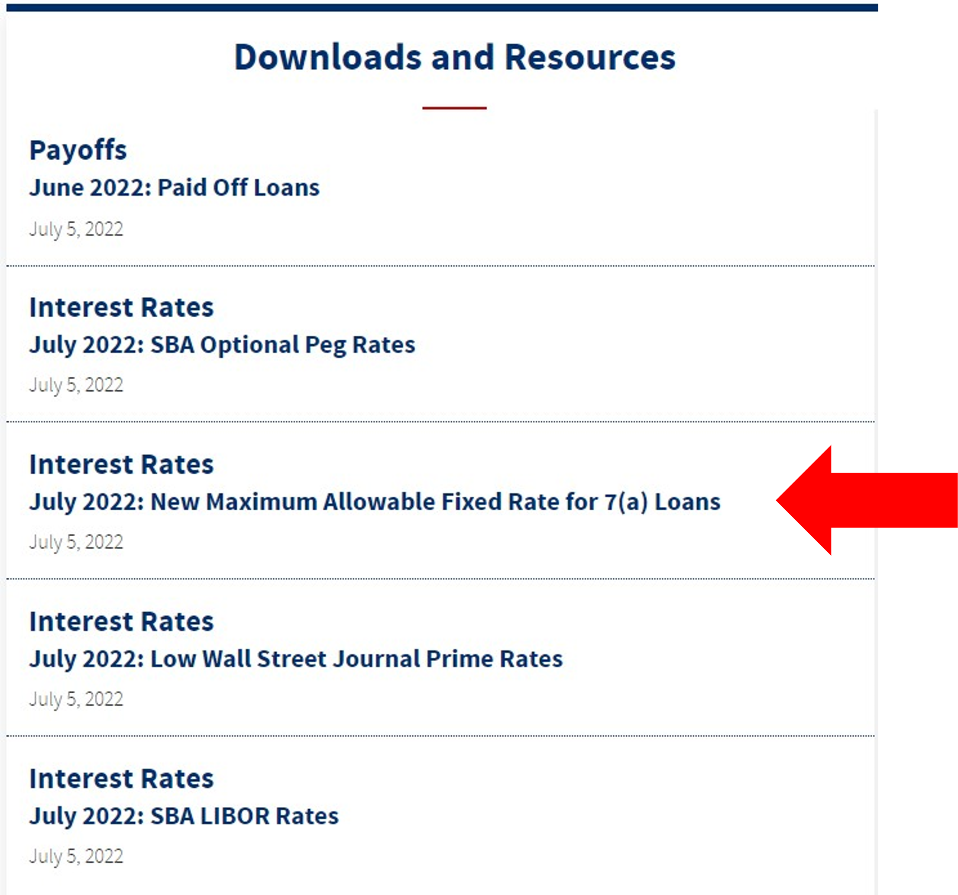
7(a) Fixed Interest Rates
FTA Wiki Page
Where to find the published maximum 7(a) fixed interest rates:
  Use the FTA wiki page to download a spreadsheet with current & historical fixed interest rate maximums by loan amount
  SOP 50 10 6 currently sends readers to CAFS – please use FTA wiki instead. When the SOP is updated, we will refer readers to the FTA wiki

Slide 25
IRS Announces Draft Changes to IRS Form 4506-C
IRS Form 4506-C is being modernized and upgraded
Click here to see the draft revisions for use in preparing internal software updates - - Do not submit the draft form to IRS
Signatures are required for any taxpayer listed on the filed tax forms
Required as of December 1, 2022: The revised form will be the only acceptable form for IVES
Subscribe here for IRS 4506 updates via GovDelivery
Please direct all questions to IRS

Slide 26
Reminder: Tax Verification
SOP 50 10 6, Part 2, Section A, Ch. 6, Para. B., page 206:
Provides an exception to the requirement to obtain tax return transcripts for the most recent fiscal year if the year-end is within 6 months of the date SBA received the application
  Reminder: If the Applicant’s fiscal year coincides with the calendar year, we are now past the 6-month window for this exception for 2021 – that means 2021 tax transcript is required
If the Applicant has filed an extension for the most recent fiscal year, the Lender must obtain a copy of the extension along with evidence of payment of estimated taxes
Notes:
Procedural Notice 5000-829416, effective March 9, 2022
Instructions for IRS Form 8821

Slide 27
“The Deregulatory Rule”
Final Rule: Regulatory Reform Initiative: Streamlining and Modernizing the 7(a), Microloan, and 504 Loan Program to Reduce Unnecessary Regulatory Burden
Effective August 1, 2022

Slide 28
Background and Purpose of the Regulatory Reform Initiative
Proposed rule (85 FR 80676) published on Dec. 14, 2020; comment period closed on Feb. 12, 2021
Final Rule (87 FR 38900) published on June 30, 2022; effective date: Aug. 1, 2022
Purpose:
  Remove or revise regulations that are obsolete, unnecessary, ineffective or burdensome
  Technical amendments to regulations to incorporate recent statutory changes and other non-substantive changes
Sections Impacted: 13 CFR Part 120, “Business Loans”
NOTE: This slide deck only addresses changes affecting the 7(a) Loan Program. See the Final Rule for comprehensive changes.

Slide 29
13 CFR 120.103 Farm Enterprises
§ 120.103 – removed this Section on Farm Enterprises because it references an outdated Memorandum of Understanding with USDA
No impact - SBA already has statutory authority to provide non-disaster business loans to farm enterprises, which remain eligible for SBA financing

Slide 30
13 CFR 120.110 What businesses are ineligible for SBA business loans?
§ 120.110(h) “Businesses engaged in any illegal activity” amended to read “Businesses engaged in any activity that is illegal under Federal, State, or local law”
  Why? To make it clear that the business is ineligible if it is engaged in any activity that is illegal at any level of government in the jurisdiction in which the business is operating (Already in SOP 50 10 6)
  No impact
§ 120.110 (k) SBA removed and reserved paragraph (k), regarding businesses being ineligible if “principally engaged in teaching, instructing, counseling or indoctrinating religion or religious beliefs, whether in a religious or secular setting.”
  What does this mean? A business is not automatically ineligible simply because it engages in these activities; rather, SBA will review the loan application to ensure that loan proceeds won’t be used to finance religious activities
  If it appears that loan proceeds may be used to fund religious activities - The guidance provided in SOP 50 10 6, page 146, regarding the requirement to submit SBA Form 1971, “Religious Eligibility Worksheet,” to SBA for review will remain in effect
Notes:
Over 99% of the comments received on this Final Rule, 2,651, were in response to the proposed removal of 120.110(k) from the regulations. This provision currently provides that businesses principally engaged in teaching, instructing, counseling or indoctrinating religion or religious beliefs are ineligible for SBA financial assistance; all but one of the comments received expressed opposition to its removal. SBA explained that this provision, which was promulgated in 1996, is not consistent with current Supreme Court jurisprudence in that it focuses on the nature of the business and whether the business has a major religious component instead of on how the loan proceeds from any SBA business loan will be used. The Court held that the government may not deny a public benefit to an entity solely because of its religious status, character, or identity. Accordingly, SBA proposed to remove paragraph (k) from section 120.110 and to apply relevant case law to assure that the intended use of the loan proceeds of SBA business loans is consistent with the requirements of the First Amendment’s Establishment Clause.

Slide 31
13 CFR 120.110(n) “What businesses are ineligible for SBA business loans?
§ 120.110(n)
  Revised from: “Businesses with an Associate who is incarcerated, on probation, on parole, or has been indicted for a felony or a crime of moral turpitude”
  Revised to: “Businesses with an Associate who is incarcerated, on probation, on parole, or is under indictment for a felony or any crime involving or relating to financial misconduct or a false statement”
    Changed “has been indicted” to “is under indictment.” Why? SBA wanted to clarify that the business would be ineligible only if an Associate is under indictment when the business submits a loan application or prior to loan approval
    Changed “crime of moral turpitude” to “crime involving or related to financial misconduct or a false statement.” Why? “Moral turpitude” is hard to define and can vary by State. The new standard is more relevant to SBA’s responsibility to carry out the business loan programs in a financially prudent manner
    Similar language already in SOP 50 10 6 (pg 152) and SBA Form 1919
    (Note: this rule is waived for CA Pilot Program as of May 31, 2022)
Notes:
From the Dereg Rule: SBA proposed to revise paragraph (n), which currently provides that a business is ineligible if an Associate “is incarcerated, on probation, on parole, or has been indicted for a felony or a crime of moral turpitude”. With respect to ineligibility based on indictment for a crime, SBA proposed to change the phrase to “is under indictment” from “has been indicted”. SBA explained that it wants to make clear, consistent with its longstanding interpretation of this regulation, that the business is not ineligible if an Associate has a history of ever being indicted (but not convicted) but would be ineligible only if an Associate is under indictment when the business submits a loan application or prior to loan approval. In addition, SBA proposed to replace the phrase, “a crime of moral turpitude”, which is not always easily defined and can vary by State, with “a crime involving or related to financial misconduct or a false statement”. SBA explained that it believes that the proposed standard is clearer and more relevant to SBA’s responsibility to carry out the business loan programs in a financially prudent manner. SBA received one supporting comment from a trade association and no opposing comments. SBA is adopting the changes as proposed.

Slide 32
13 CFR 120.120 – Eligible Uses of Proceeds? (Land)
  § 120.120
      Proposed change: Proposed to clarify that loan proceeds may be used to purchase or lease land only if it will actively be used in the applicant’s business operations
      Final Action: Not adopted. SBA will review and study the issue.
      No impact. SBA’s existing policy prohibits loans for passive purposes; therefore, the business must make immediate use of property purchased with SBA loan proceeds (SOP 50 10 6, pg 142-143)

Slide 33
13 CFR 120.212 - 7(a) Loan Maturities
  § 120.212 - 7(a) loan maturities
      Revised from: Loan term is 10 years or less unless the loan finances or refinances real estate or equipment with a useful life exceeding ten years
      Amended: Loan term is 10 years or less, unless the loan finances or refinances real estate or equipment with a useful life exceeding ten years. The term for a loan to finance equipment and/or leasehold improvements may include an additional reasonable period, not to exceed 12 months, when necessary to complete the installation of the equipment and/or complete the leasehold improvements
      No impact. Already in SOP 50 10 6, pg 238

Slide 34
13 CFR 120.214(c) LIBOR Sunset – 7(a) and Secondary Market Impact
§ 120.214(c) Removes LIBOR as a base rate option for variable interest rate 7(a) loans (Note: This is effective Aug. 1, 2022 – SOP 50 10 6 will be updated to reflect this policy)
LIBOR – Sunsets as of June 30, 2023 for all US Dollar tenor
Lenders may only use Prime or Optional Peg Rate as the variable interest base rate for loans approved after the effective date of the rule
If an alternative rate becomes available, SBA will provide notice in the Federal Register
For loans outstanding with interest rates based on LIBOR, Lenders should examine loan documents to determine the timing of a change to either a Prime or Optional Peg Rate, and work with Borrowers to modify loan documents before June 30, 2023
32

Slide 35
13 CFR 120.214 - 7(a) Variable Interest Rates
  § 120.214(d)
  Before Dereg Rule: Based on loan maturities – more than/less than 7 years
  Effective Aug. 1, 2022: Loan amounts are used as basis (rather than loan maturity)
  Maximum variable interest rates for all 7(a) loans:
    $50,000 or less: Base rate + 6.5
    $50,001 - $250,000: Base rate + 6%
    $250,001 - $350,000: Base rate + 4.5%
    $350,001 and greater: Base rate + 3%
  Allows Community Advantage Pilot Program Lenders to adopt these interest rates (Note: CA Lenders already have authority to use these rates for loans up to $350,000 in accordance with Federal Register Notice 87 FR 25398, April 29, 2022, effective May 31, 2022)
  (Note: SOP 50 10 6 will be updated to reflect this policy)
Notes:
Dereg Rule revises 120.214(d) to state:
(d) Maximum Allowable Variable Interest Rates. The maximum allowable variable interest rates are set forth below, with the initial maximum allowable rate for the loan determined as of the date SBA receives the loan application:
(1) For all 7(a) loans of $50,000 and less, the interest rate shall not exceed 6.5 percentage points over the base rate;
(2) For all 7(a) loans of more than $50,000 and up to and including $250,000, the maximum interest rate shall not exceed 6.0 percentage points over the base rate;
(3) For all 7(a) loans of more than $250,000 and up to and including $350,000, the maximum interest rate shall not exceed 4.5 percentage points over the base rate; and
(4) For all 7(a) loans of more than $350,000, the maximum interest rate shall not exceed 3.0 percentage points over the base rate.

Slide 36
13 CFR 120.214 - 7(a) Interest Rates
  § 120.214 (continued)
  Only for SBA Express and Export Express:
    May continue to use the same base rates, change intervals, payment accruals, and other interest rate terms used on Lender’s similarly-sized non-SBA guaranteed commercial loans BUT initial rate must not exceed SBA’s maximum interest rates
    May sell on secondary market only if the base rate is one of the base rates allowed in 120.214(c) (i.e., WSJ Prime, Optional Peg Rate, or alternative rate to be set by SBA as published in Federal Register)
    No impact (except for exclusion of LIBOR) - The above are already in SOP 50 10 6 (except for exclusion of LIBOR as a base rate for selling into secondary market)

Slide 37
13 CFR 120.220(a)(3) SBA Express Program- Fees for Loans To Veterans
    § 120.220(a)(3) updated:
    Before CARES Act & Dereg Rule: Small Business Act, section 7(a)(31), stated that the upfront guarantee fee for SBA Express loans to businesses owned and controlled by a veteran or spouse of a veteran for fiscal years is waived except in any fiscal year in which 7(a) program is not operating at zero subsidy
      The CARES Act removed the exception. Therefore, SBA removed it from section 120.220(a)(3)
      SBA conformed the regulations with the CARES Act through the Dereg Rule. This means going forward on a permanent basis for SBA Express loans, the upfront guarantee fee is waived for loans to businesses owned and controlled by a veteran or spouse of a veteran
      Statute always takes precedence over regulations. SBA implemented this statutory mandate via SBA Information Notice 5000-818641, Sept. 7, 2021

Slide 38
13 CFR 120.220(b) “When the Guaranty Fee is Payable.”
§ 120.220(b)
Proposed: Shorten the date by which a Lender must pay the guaranty fee on an approved 7(a) loan with a maturity of more than one year – Shorten from within 90 calendar days of loan approval to 45 calendar days
Final Rule: SBA did not adopt this change
Why? Comments from the industry:
  The Lender cannot be reimbursed by the borrower for the guaranty fee until after the borrower receives its first disbursement of the loan proceeds (and the Lender may not disburse the loan for the sole purpose of funding the guaranty fee)
  There are cases when there is a delay between loan approval and loan disbursement – the 90-day deadline to pay the fee allows some grace time for the loan to disburse and for Lender to be reimbursed by borrower for the guaranty fee and avoids stressing lender liquidity

Slide 39
13 CFR 120.350 & 352 – Qualified Employee Trusts (ESOPs)
§§ 120.350 and 120.352 – ESOP guidance updated to incorporate statutory changes in Section 862 of the John S. McCain National Defense Authorizations Act Pub L. 115-232 in 2018 to sync with SOP 50 10 6:
Permits SBA to guarantee a loan to the small business concern rather than a qualified employee trust if the proceeds from the loan are used only to make a loan to a qualified employee trust that results in the qualified employee trust owning at least 51 percent of the small business concern
SBA published the Express Rule to include the appropriate changes in the John McCain National Defense Authorizations Act into regulation, but Congress rescinded the Express Rule via the CARES Act. Nonetheless, SOP 50 10 6, pgs 137-138, already appropriately implements the John McCain Act

Slide 40
13 CFR 120.470(d)(1) - SBLCs
    § 120.470(d)(1) “Dual Control”: Increased the dollar amount that a small business lending company (SBLC) may disburse funds with the signature of only one bonded officer from $1,000 to $10,000 provided that such action is covered under the SBLC’s fidelity bond (Without this change, signatures of 2 bonded officers would be required = “Dual control”)
    SBA believes this change will reduce burden on SBLCs without introducing significant risk to the program

Slide 41
13 CFR 120.540 & 542 - Liquidation & Litigation, Payment by SBA of Fees
Aligns the regulations with SBA’s current organizational structure.
§ 120.540(g) – Appeals of liquidation and litigation plans: Revised. Appeals on liquidation plans will now be submitted to the Director of the Office of Financial Program (D/OFPO) rather than the Director of OFA (D/FA)
§ 120.542(d) & (e) – Liquidation & litigation costs - Payment by SBA of legal fees and other expenses: Revised. Appeals on fees and costs incurred in liquidations and litigations will now go to the D/OFPO rather than D/FA

Slide 42
The Deregulatory Rule - What didn’t happen?
  What didn’t happen?
  SBA had proposed to remove references to 7(a) direct and immediate participation loans…
  SBA opted not to remove these references in order to retain the option for these programs if budget authority becomes available

Slide 43

Save the Date – 2022 Updates
7(a) Connect Quarterly Update – 3:00 p.m. Eastern
  Quarterly call for 7(a) Lenders and SBA staff
  October 12, 2022
504 Connect Quarterly Update – 3:00 p.m. Eastern
  Quarterly call for CDCs, Third Party Lenders and SBA staff
  September 20, 2022
Subscribe/unsubscribe:
  7(a) OFA updates
  7(a) Community Advantage Pilot Program updates
  504 OFA updates

